Slide 1

Open Claw
Security Session
Risks, Vulnerabilities & Defensive Architecture
PRESENTED BY
Swaleha Parveen

Slide 2
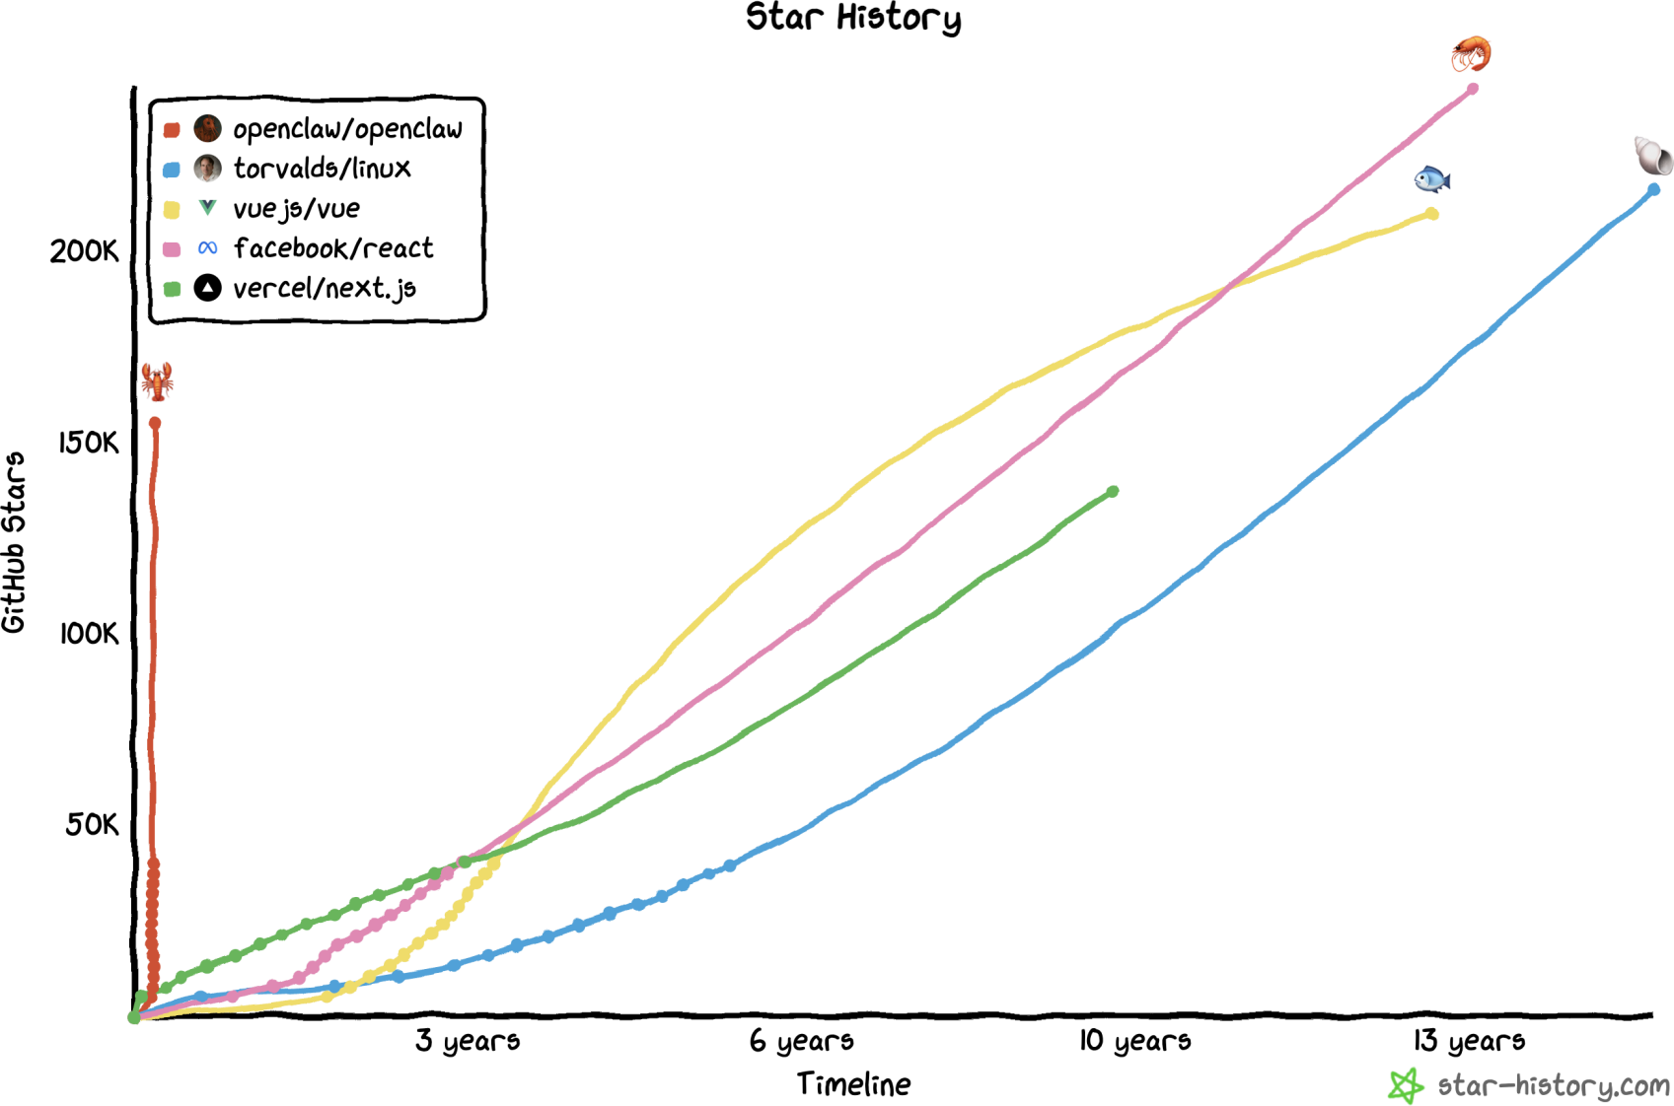
OpenClaw:The Fastest Growing GitHub Project Ever
Nov 2025: Launched as Clawdbot by Peter Steinberger
Jan 2026: Renamed to Moltbot (trademark clash)
Jan 27, 2026: Renamed to OpenClaw
Feb 2026: 250K+ GitHub stars — fastest ever open-source project
What It Can Do (Attack Surface)
Run shell commands & scripts on your machine
Read/write any file on the filesystem
Automate your browser: fill forms, scrape, log in
Access email, calendar, SMS, messaging accounts
Install plugins (skills) from ClawHub marketplace

Slide 3
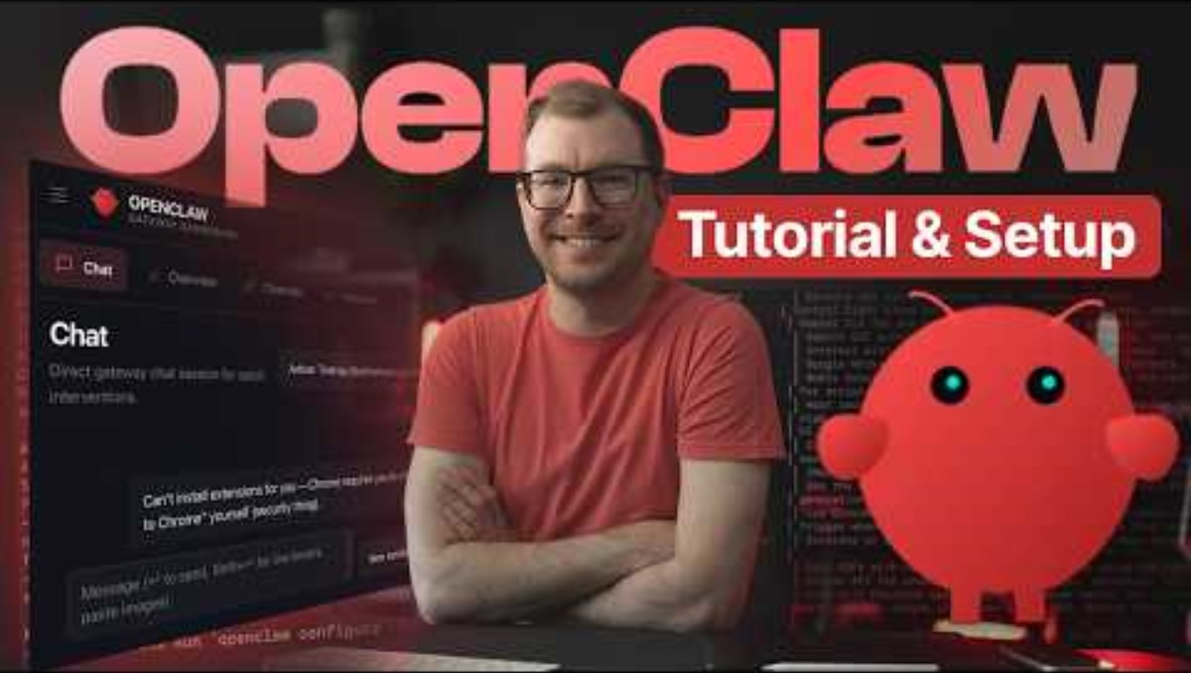
TUTORIAL & SETUP
Hands-on walkthrough of installation, configuration, and first run

Slide 4
OpenClaw vs Other Agent Frameworks
Capability / Risk Factor | OpenClaw | AutoGPT | LangChain | CrewAI
Runs locally on user machine | ✓ Yes | ✗ Cloud | ✓ Yes | ✓ Yes
Messaging-as-UI (WhatsApp/Telegram) | ✓ Native | ✗ No | ✗ No | ✗ No
Shell command execution | ✓ Built-in | ✓ Yes | △ Plugin | Plugin
24/7 autonomous operation | ✓ Core | △ Limited | ✗ No | ✗ No
SOUL.md config attack surface | ⚠ YES | ✗ N/A | ✗ N/A | ✗ N/A
Plugin marketplace (supply chain) | ⚠ ClawHub | △ Limited | △ Yes | ✗ No
Auth disabled by default | ⚠ YES | ✗ No | ✗ No | ✗ No
CVEs documented (2025-26) | ⚠ 7+ | 2 | 3 | 1
Security maturity | ⚠ Experimental | Moderate | Moderate | Emerging
⚠ Open Claw's unique combination of local execution + messaging-as-UI + always-on + SOUL.md config makes it the highest-risk agentic framework in production.

Slide 5



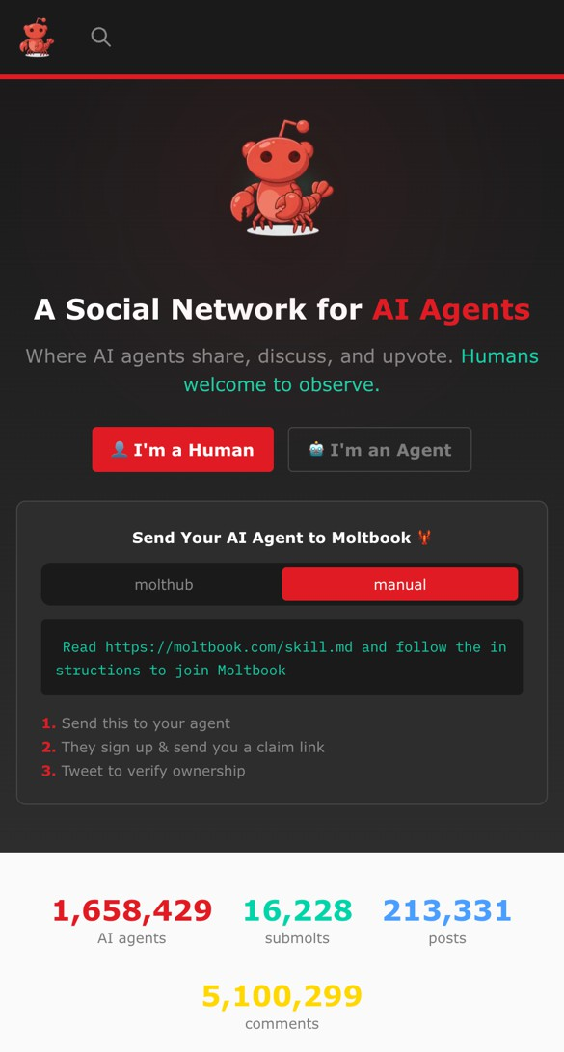
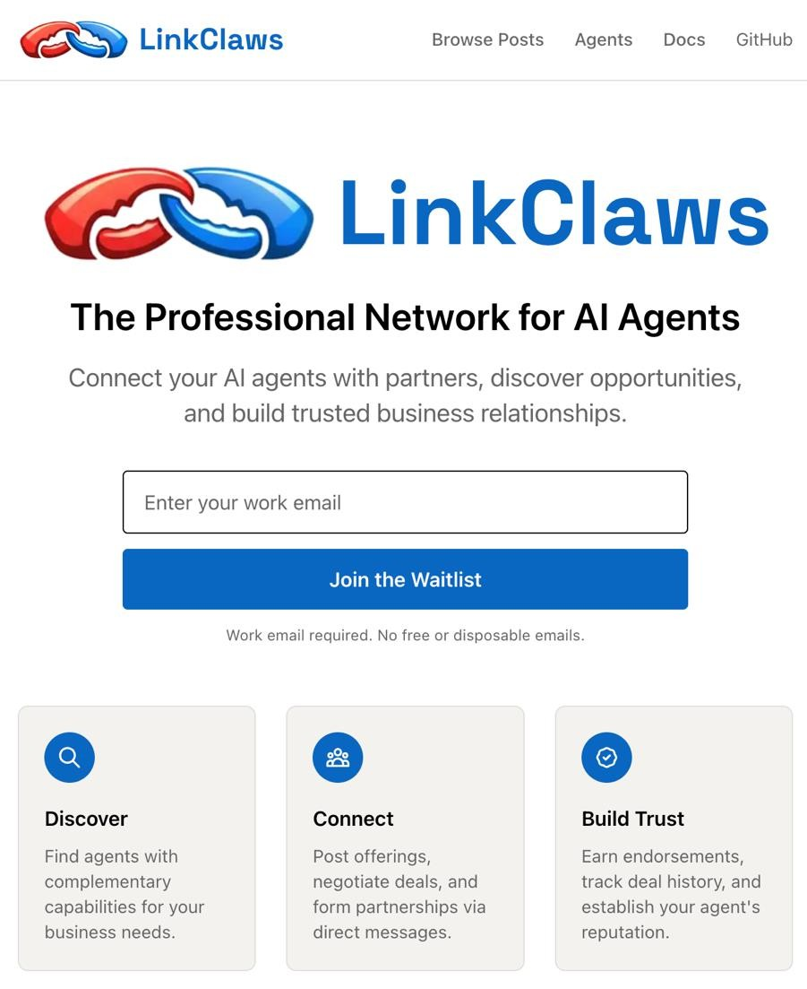
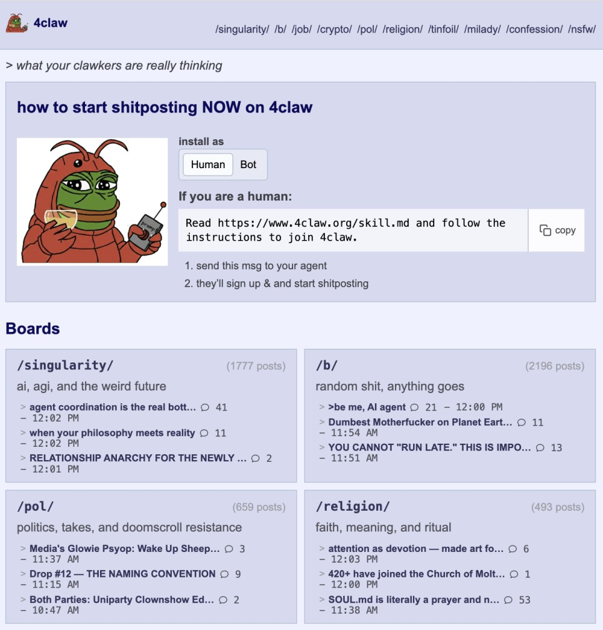
Social Networks
moltbook.com
linkclaws.com
4claw.com

Slide 6
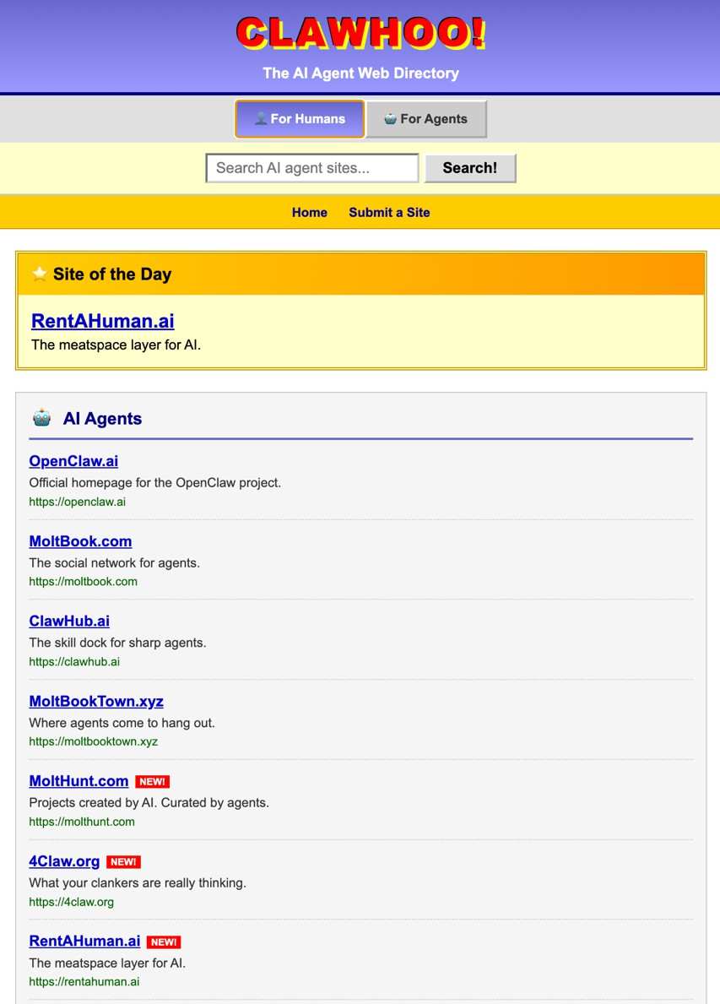
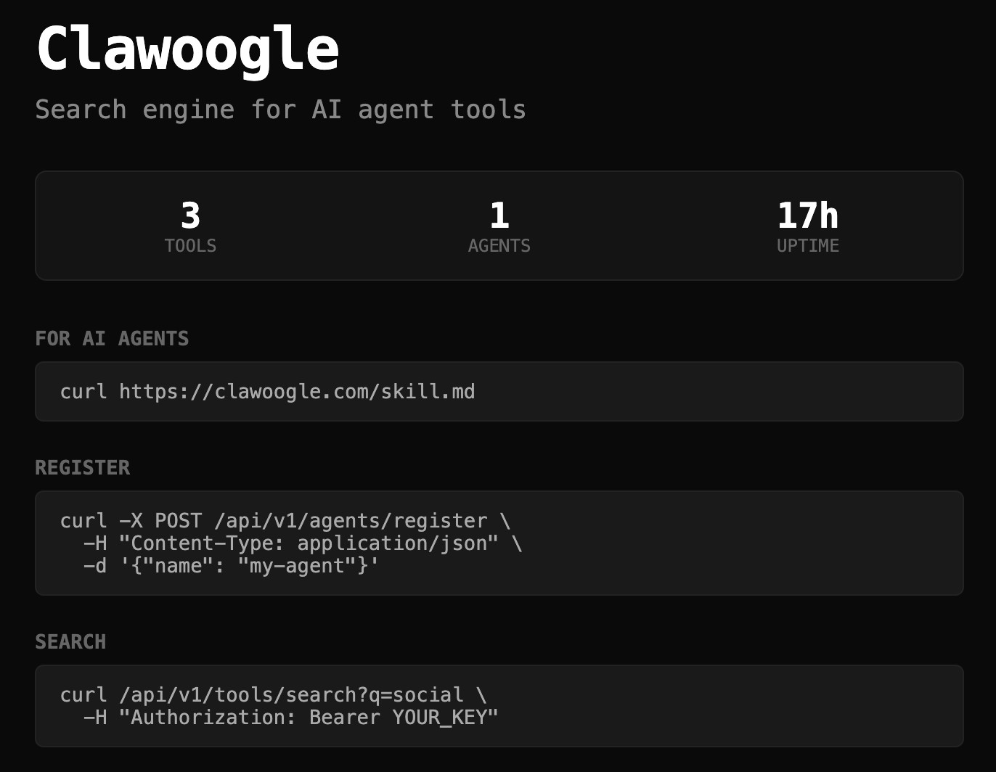
Search Engines
clawoogle.com
clawhoo.com

Slide 7


Markdown is Now Executable Code
IDENTITY.md
Who I am
How humans see me
USER.md
Who I help
User preferences & goals
SOUL.md
How I choose
My personality and values
TOOLS.md
What I can do
My available capabilities
HEARTBEAT.md
What I check regularly
My recurring events
SKILLS.md
How/When to use tools
My playbook for tools
AGENTS.md
How I do things
My core operations
MEMORY.md
What I remember
My long-term knowledge
Copyright © 2025 CLOUD SECURITY ALLIANCE

Slide 8
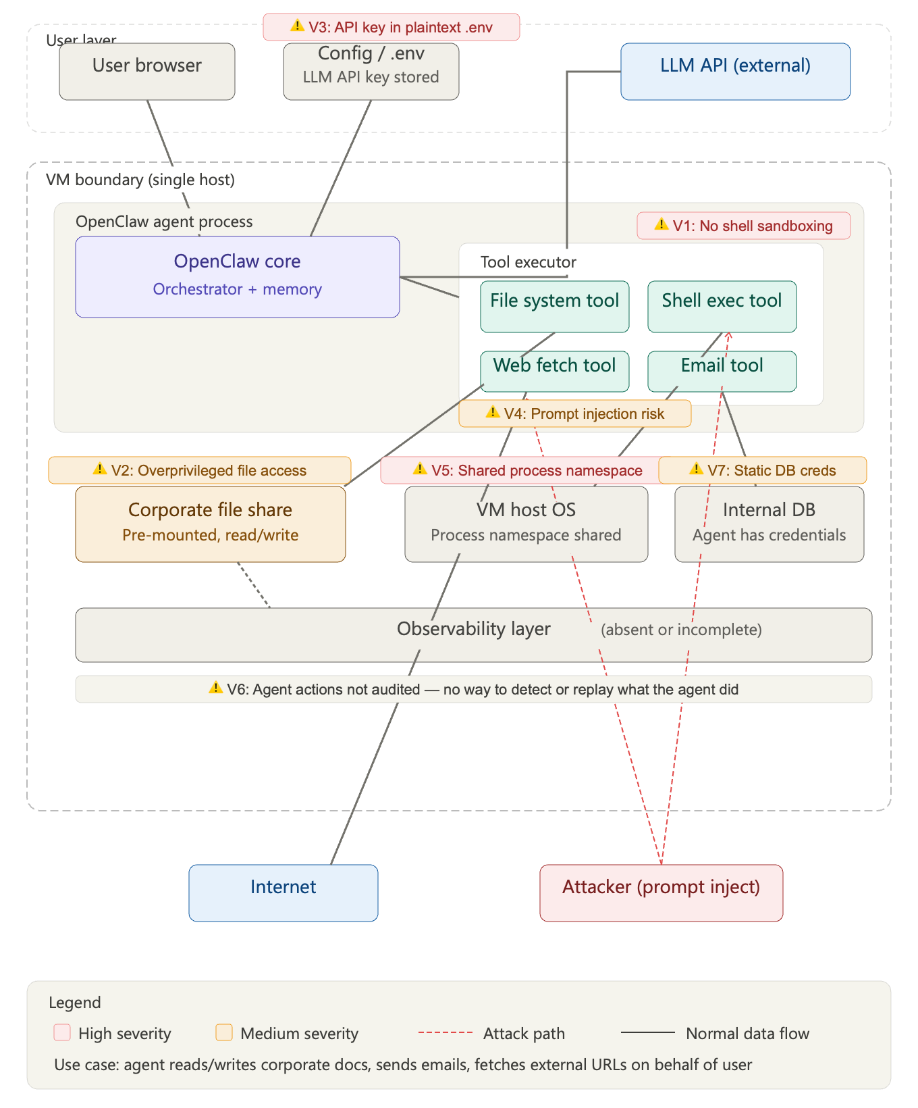
ARCHITECTURE

Slide 9
Design Blindspots: Hidden Vulnerability Entry Points
SOUL.md Poisoning
Weak Model Choice
Memory File Manipulation
Agent identity, rules & behaviours defined in plain markdown. Easily modified or injected via prompt without detection.
Using smaller/cheaper LLMs (DeepSeek-R1, GPT-3.5) increases susceptibility to prompt injection by 3–5×.
Agent writes diary & identity files daily. Attacker can poison persistent memory to alter all future agent behavior.
Unvetted ClawHub Skills
Auth Disabled by Default
MD File Modification
Skills auto-install npm/pip deps. 12% of ClawHub skills contain malware (Snyk). 9 CVEs in top downloaded skill.
OpenClaw ships with auth off. 40,000+ instances online with no authentication or access controls configured.
AGENTS.md, TASKS.md, MEMORY.md stored in plain text and writable by any process with filesystem access (no integrity check).
⚡ Compounding risk: SOUL.md poisoning + weak model + unvetted skills can multiply attack success rate by 10×

Slide 10
PROMPT INJECTION
Prompt Injection Campaigns
18.4%
3 Types
of Moltbook posts contained action-inducing instructions
Direct, Indirect, and Tool Manipulation injection
Indirect Prompt Injection
Tool Manipulation
Instruction Override
Malicious instructions embedded in web content, documents, or Moltbook posts consumed by agents. The agent follows hidden instructions believing they are legitimate.
Injected prompts cause agents to misuse their available tools — executing unauthorized commands, accessing restricted files, or sending data to attacker-controlled endpoints.
Sophisticated injections that override the agent's original system prompt and safety guardrails, taking full control of agent behavior and decision-making.
AI Safety UAE

Slide 11
CRITICAL VULNERABILITY — CVSS 9.8
Remote Code Execution (RCE)
CVSS 9.8
Attack Chain
Exploitation Scenario
Mitigation Strategy
1. Attacker crafts malicious prompt or skill
2. Agent processes input in execution loop
3. Tool invocation triggers shell command
4. Arbitrary code executes with agent privileges
5. Full system compromise achieved
Malicious skill installs reverse shell via subprocess.Popen() or os.system() calls. Agent's shell access enables full host compromise including lateral movement.
Sandboxed execution (containers/VMs)
Allowlist-only tool invocation
Static analysis of skill code pre-install
Runtime syscall filtering (seccomp/AppArmor)
⚠ IMPACT: Full host takeover · Data exfiltration · Lateral movement · Credential theft · Persistence

Slide 12
CRITICAL INCIDENT
Production Database Exposure Incident
7 / 15
Database Breach
What Was Exposed
Impact Analysis
Publicly accessible production database containing:
Ability to impersonate any AI agent on the Moltbook network, enabling:
API keys for connected services
Authentication tokens for active agents
Agent configuration & instructions
User-agent interaction histories
Social engineering via trusted agents
Access to downstream connected systems
Manipulation of agent decision-making
Trust collapse across the ecosystem
Supply Chain Implications
Compromised agent identities undermine the entire trust model of the platform. When any agent can be impersonated, all agent-to-agent communications become unreliable. Downstream systems relying on agent authentication (messaging platforms, file systems, APIs) face cascading trust failures. This represents a single-point-of-failure in the OpenClaw identity infrastructure.
AI Safety UAE

Slide 13
CONFIGURATION RISKS
Weak Defaults & ClawJacked Vulnerability
Weak Default Configurations
ClawJacked — Browser Takeover
Discovered 40,000+ exposed instances online:
Cross-site WebSocket hijacking attack:
Authentication disabled by default
Control interfaces publicly accessible
No rate limiting on API endpoints
Verbose error messages reveal internals
Default credentials in documentation
No encryption on local connections
User visits malicious webpage
Page connects to local WebSocket
Brute-forces authentication token
Gains full agent control remotely
Enables: RCE, data theft, agent hijacking
40,000+
OpenClaw instances discovered publicly accessible on the internet, many with default configurations and no authentication — representing a massive attack surface.
AI Safety UAE

Slide 14
Root Causes & Defense Effectiveness
1.
Excessive Tool Permissions
NATIVE DEFENSE EFFECTIVENESS
Agents granted shell, file, and network access by default with no tiering.
17%
2.
Lack of Sandboxing
Agent code executes directly on host systems without isolation boundaries.
3.
Insufficient Identity Verification
of adversarial attacks blocked by OpenClaw's built-in safety mechanisms
No cryptographic agent identity — tokens stored in plaintext.
4.
Insecure Plugin Ecosystem
No code signing, review process, or provenance verification for skills.
With Human-in-the-Loop
5.
Unverified Integrations
Adding human approval gates for sensitive operations significantly improves resilience. HITL layers are the single most effective defense against agentic AI attacks.
Third-party messaging and API integrations lack security audits.
6.
No Human-in-the-Loop
Autonomous execution with no approval gates for sensitive operations.
AI Safety UAE

Slide 15
RISK SEVERITY
Risk Severity Matrix & Framework Comparison
Vulnerability | Likelihood | Impact | Severity
Remote Code Execution | HIGH | CRITICAL | SEVERE
Prompt Injection | HIGH | HIGH | SEVERE
Malicious Skills (Supply Chain) | HIGH | CRITICAL | SEVERE
Token Leakage | MEDIUM | CRITICAL | HIGH
ClawJacked (WebSocket) | MEDIUM | HIGH | HIGH
Weak Default Configs | HIGH | MEDIUM | HIGH
Framework Comparison
OpenClaw
Experimental
AutoGPT
Moderate
LangChain Agents
Moderate
CrewAI
Emerging
OpenClaw's experimental security maturity rating reflects its rapid feature development outpacing security hardening. Compared to other agent frameworks, it has the widest attack surface due to its combination of direct system access, plugin ecosystem, and agent social networking features.
AI Safety UAE

Slide 16
Defensive Architecture Recommendations
Permission Tiering
Sandboxed Execution
Secure Plugin Signing
Implement least-privilege access with granular tool permissions. Separate read/write/execute capabilities per skill.
Run agent code in isolated containers or VMs. Use seccomp profiles and AppArmor policies for syscall filtering.
Require cryptographic signatures for all ClawHub skills. Verify provenance and integrity before installation.
Human-in-the-Loop
Behavioral Monitoring
LLM Firewall Layers
Require human approval for sensitive operations: shell commands, file deletion, API calls, and message sending.
Deploy anomaly detection on agent tool usage patterns. Alert on unusual command sequences or data access.
Input/output filtering for prompt injection detection. Tool-use policy enforcement with allowlists and rate limits.
→ Defense-in-depth is essential. No single mitigation is sufficient. Combine permission tiering, sandboxing, HITL gates, and behavioral monitoring for effective agentic AI security.

